Slide 1
Vector Database Selection
Patrick Stingley
7/15/2024

Slide 2
This presentation was based on many sources, but two of the primary sources were: “Survey of Vector Database Management Systems” by James Jie Pan · Jianguo Wang · Guoliang Li, Oct 21st of 2023, https://arxiv.org/pdf/2310.14021 Oct 21st of 2023. Generative AI Cloud Platforms: AWS, Azure, or Google? By Janakiram MSV, The New Stack, Jun 30th, 2023, https://thenewstack.io/generative-ai-cloud-services-aws-azure-or-google-cloud/
Patrick Stingley 7/15/2024

Slide 3
Why Vector Databases?
Artificial Intelligence systems use many kinds of data.
Relational databases are only good at tabular data.
This gave rise to NoSQL databases
AI systems need to be able to give a “close counts” answer.
RDBMSs and NoSQL databases give exact match responses.
Vector Databases (VDBMSs) give nearest neighbor responses.
Patrick Stingley 7/15/2024

Slide 4
How VDBMSs work in AI
Data of all kinds is turned into vectors
Tabular data, images, video, streaming data
Vectors are strings of floating point numbers
The VDBMS stores these vectors
Closest to other vectors most like each other
(Much as ISAM)
A query comes in and it is vectorized.
The query vector is inserted into the database and the closest vectors are returned.
This is why using an AI tool publishes your information.
Sometimes the distance to the nearest neighbor is returned (range)
Patrick Stingley 7/15/2024

Slide 5
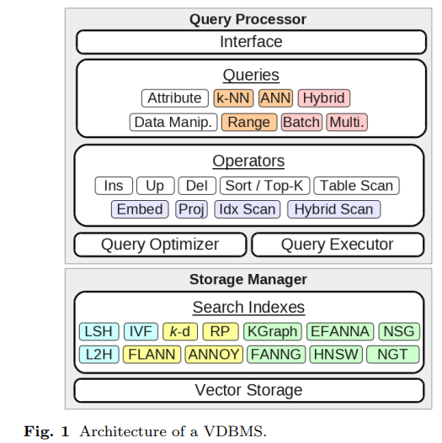
Architecture of a VDBMS
Query Processor:
Provides the user interface
Forms the queries
Supports operators
Optimizes queries
Executes queries
Returns results
Storage Manager:
Creates Search Indices
Stores vectors
Table based (blue)
Tree based (yellow)
Graph based (green)
Patrick Stingley 7/15/2024

Slide 6
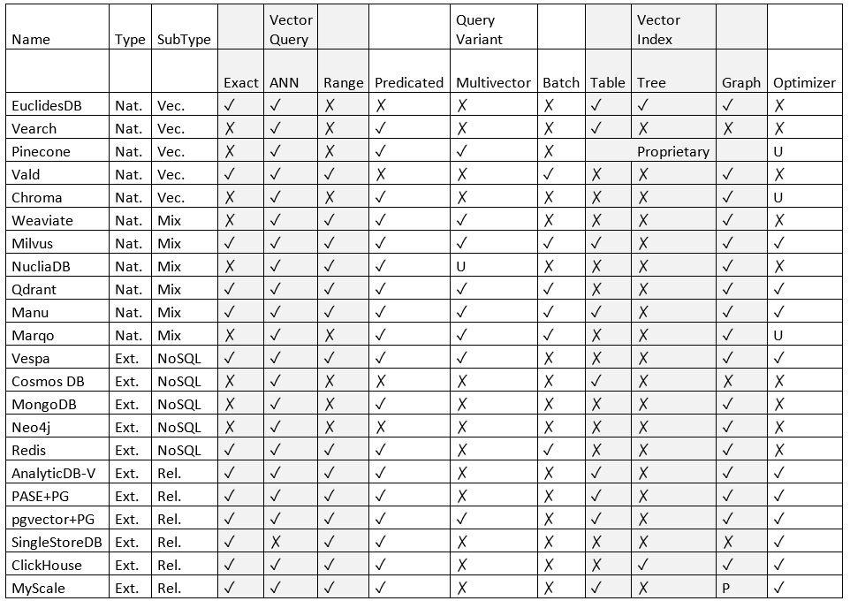
Start with table 7
20 VDBMSs – actually 22
11 Natural VDBMSs
11 Extended (bolt-ons)
+
Search Engines with
vector capabilities
2 Additional vector stores
Lucene
Elastic Search
Meta Faiss
Cassandra
Databricks
Patrick Stingley 7/15/2024

Slide 7
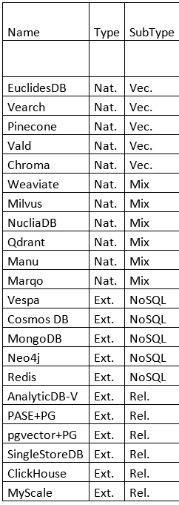
Start with table 7
Two kinds of vector databases
Native vector databases
Extended.
Native databases are built from the ground up to be vector databases
Extended databases have the vector capability bolted on.
Two kinds of native vector databases:
Vector
Mixed
Two kinds of Extended vector databases:
those built on NoSQL
those built on RDBMSs
Patrick Stingley 7/15/2024

Slide 8
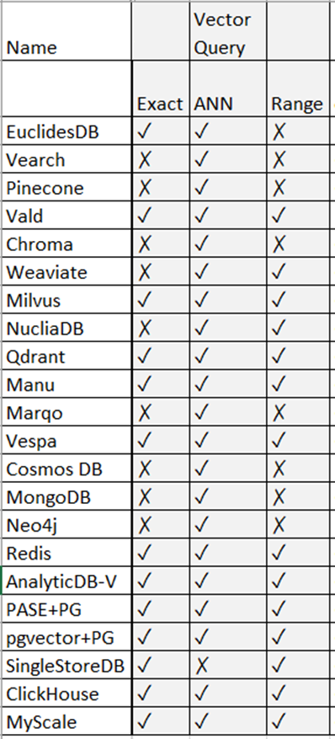
Table 7 - Vector Queries
Typically the VDBs that are bolt-ons to RDBMSs, such as pgvector support exact matching because of the relational databases underlying them.
ANNs (Approximate k-Nearest Neighbor) are actually a family of algorithms that find the vector(s) with the closest values to the query vector.
It is notable that SingleStore doesn’t have this. Instead it uses its SQL processing to process associated vectors. Although it cannot provide the versatility that ANN based queries can, SingleStore offers high speed reading writing and querying. It uses its association between the SQL and the vectors to allow it to handle all manner of data types.
PASE and pgvector are bolt-ons to postgress, providing it with vector capabilities, including ANN (semantic) search.
A Range Query shows how far away the respondent vectors are, rather than a list of the closest ones. It’s possible to set a threshold.
For instance, suppose a query was: “What animal is also a spaceship, if none of them are closer than X value, return none” (which it would be in this case). A typical ANN response would be to provide a list of animals that are closest in the database to spaceship, regardless of the fact that the responses are non-sensical.

Slide 9
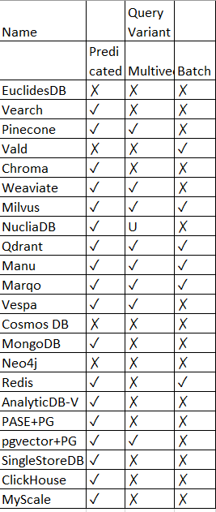
Table 7 – Query Variants
Some VDBMSs support variants on the aforementioned basic query types. The three variant types mentioned in the paper were:
Predicated - Hybrid queries allowing searching among multiple kinds of data.
Multi-vector - Multi-Vector Queries – Some VDBSs support multi-vector queries. These are MQSF (Multi Query Single Feature and Single Query Multi Feature (SQMF) and MQMF, but there is no support for MQMF. Examples of these might be: do people have two legs? Does John have two legs? (MQSF). What are the characteristics of people (SQMF). What are the characteristics of people? Which of these characteristics are unique to people? (MQMF)
Batched – Self explanatory
Patrick Stingley 7/15/2024

Slide 10
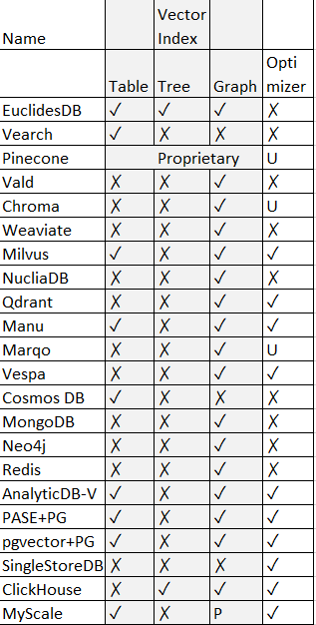
Table 7 – Vector Indexing Types (1)
Vector Indexing - Speeds up queries by reducing the number of comparisons.
There are three main kinds of vector indexing: Table, Tree and Graph.
Half of these products offer table based indexing, only two use tree based indexing. Most offer graph based indexing.
Table based:
Randomization
Learned partitions (LSH – Locality Sensitive Hashing). Breaks up the vectors into smaller buckets and then analyzes the buckets.
LSH provides tunable performance with error guarantees, requires high redundancy, increasing query and storage costs.
Learning-based techniques aim to directly learn suitable mappings without resorting to hash families. require lengthy training, are sensitive to out-of-distribution updates and are not widely supported.
One approach to mitigate the storage requirements of LSH is called quantization, which is just a fancy word for compression. However, the compression process is time consuming.
Patrick Stingley 7/15/2024

Slide 11
Table 7 – Vector Indexing Types (2)
Tree based vector indexing recursively splits the data based on proximity.
The main techniques includes pivot-based trees, k-means tree, and trees based on deep learning.
Pivot based trees are used for efficient similarity search based on a specific metric, such as Euclidian distance.
K-Means Tree is based on mean distances.
So far as deep learning tree-based approaches, these tend to rely on randomization for performing node splits. In particular, “Fast Library for ANN” (FLANN) combines randomization with learned partitioning via principal component analysis (PCA).
Graph based vector indexes use an unsupervised learning approach to guide the creation of the indexes by associating each vector with its k nearest neighbors through an iterative refinement process similar to k-means called KNNG. These approaches have been shown to perform well in practice.
Patrick Stingley 7/15/2024

Slide 12
Query Optimization
Query Optimization includes plan enumeration, followed by plan selection and then query execution. There are a number of kinds of query optimization, including:
Hybrid Operators – Typically done with a filtering mechanism
Block-First Scan
on-line blocking
off-line blocking
Visit-First Scan
Plan Enumeration
predefined plans
single plans
multiple plans
I will direct others to read this document for full descriptions of these algorithms.
I would have liked to have seen which products offered which optimizers.
Patrick Stingley 7/15/2024

Slide 13
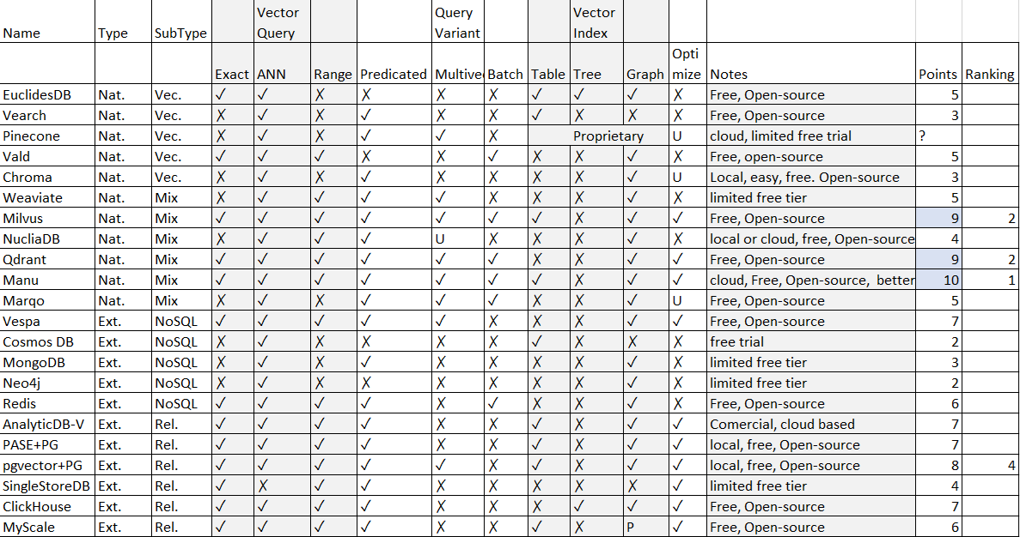
Feature based selection
Patrick Stingley 7/15/2024

Slide 14
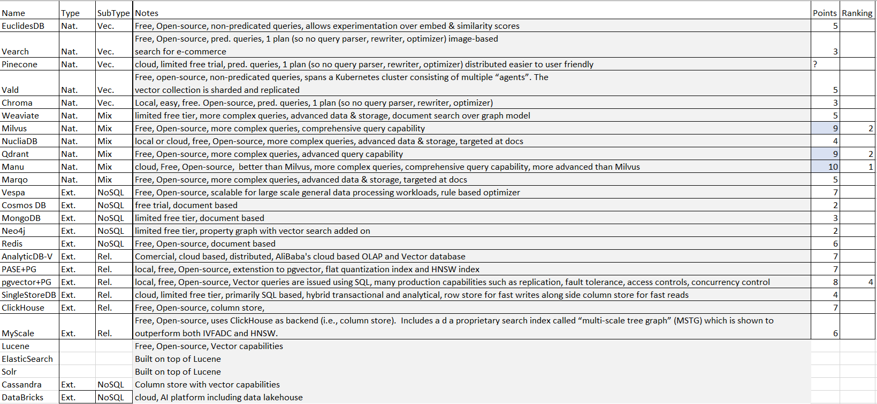
Analysis
Patrick Stingley 7/15/2024

Slide 15
Integrated Cloud Services
During the course of this research, the author has set up multiple RAG (Retrieval Augmented Generators) and multiple vector databases and has made two significant findings:
VDBMSs are difficult to feed. They won’t accept all of the data at once, which means the data has to be split. They don’t do well with data of different lengths, which means the data has to be chunked.
VDBMSs require an interface to the AI tool, which can be LangChain or LlamaIndex, or another “glue” tool. During this process LangChain was re-written, leaving the code inoperable, so the project implemented containers to keep the code stable.
There are service providers that have worked out these issues. Most of them either implement pgvector or Redis. If it is possible to implement a solution that has been worked out, this will save the project months of re-work.

Slide 16
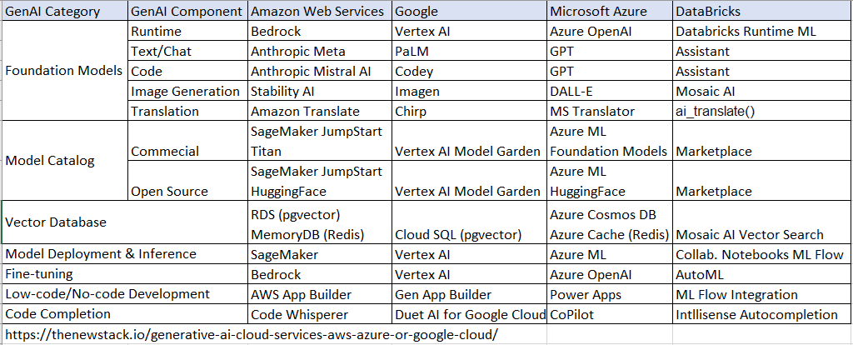
Integrated Cloud Services

Slide 17
Recommendation materials:
Recommendations:
It is recommended that the organization select an AI tool as managed services from a cloud vendor based on the contract vehicles that are in place. This will save months of experimentation and frustration.
If the organization feels the need to build their own AI stack, please consider the following:
Even though Manu has the most features it is not recommended because it is a Chinese cloud product.
All AI products have involvement by Chinese nationals.
Milvus and Qdrant tied for second / third place are recommended for further research.
Both seem to be promising products and have a following.
pgVector came in fourth in the feature count. It is a good choice because it offers a number of industrial capabilities, such as replication, fault tolerance, access controls and concurrency controls that other VDBMSs have not yet considered. Because it is based on a popular SQL database, it is possible to find database administrators who are familiar with it. I have found it to be clunky and it has been difficult to connect to AI tools via LangChain or LlamaIndex. I have not tried with other VDBMSs to see if it is worse than others.
Patrick Stingley 7/15/2024

